Slide 1
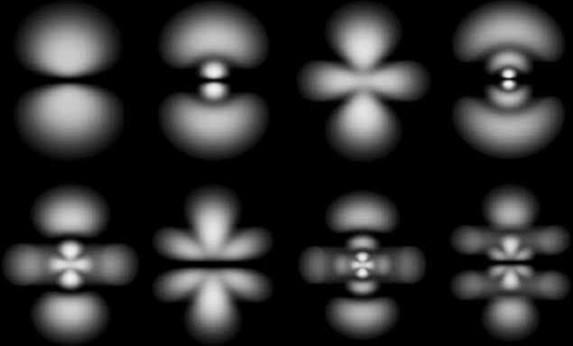
Atomic Orbitals on a Computer
http://www.askamathematician.com

Slide 2
The H-Atom Model
The hydrogen atom is three systems in one:
azimuthal angle
nucleus
θ
distance from the origin
r
φ
equatorial angle
Setting up the Schrodinger equation we get new equations to solve for each “motion”

Slide 3
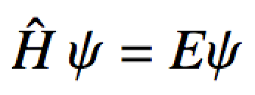
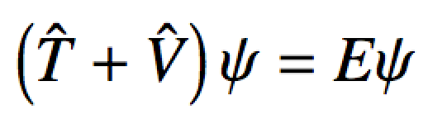
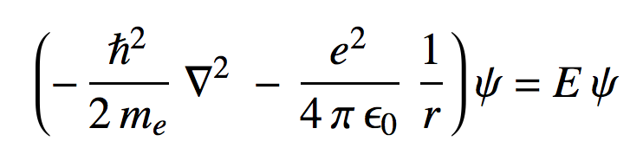
Hydrogen Atom
The Schrodinger equation:
Solution:
Radial Wave function
Angular Wave function
We want to visualize this

Slide 4
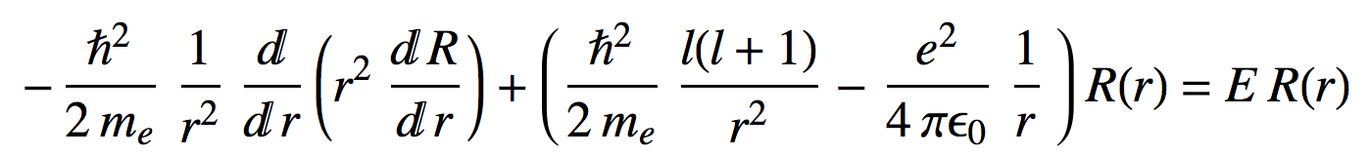
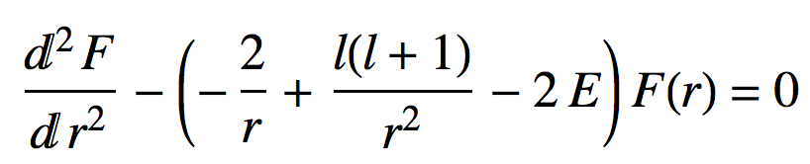
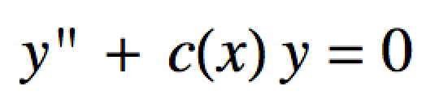
Numerov Procedure
For the Radial part of the Schrodinger equation:
This can be reformed to look like:
Just this again:
  We can use the Numerov program to solve it!
  Radial wave function depends on n and l quantum numbers

Slide 5
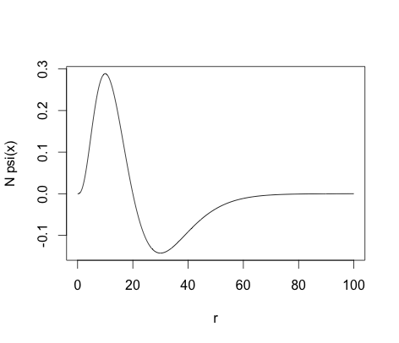
Numerov Procedure
The radial wave functions tell you what is happening inside the orbital:
# radial nodes = n – l – 1

Slide 6
numerov_control.R
#Domain (x-axis):
dr <- 0.1 # Increment on r-axis
r.min <- 1e-15 # Start of r-axis.
r.max <- 180 # End of r-axis.
r <- seq(from=r.min,to=r.max,by=dr) # r-axis
# Numerov's procedure to solve the (almost) Radial Schrodinger Equation:
n <- 6 # n = 1,2,3,...
l <- 4 # l = 0, ... , n-1 (e.g. s,p,d,f,g,.....)
Guess.Energy <- (-0.5) # Initial guess for energy of the state
max.iter <- 50
state <- (n-l-1)
Fr.info <- numerov.procedure(r,dr,"radial",state,Guess.Energy,max.iter,0.00)
# Transform F(r) back into R(r), the proper radial wave function
psi.info <- Fr.info
psi.info[,2] <- (r^-1)*Fr.info[,2]
plot(r, r^2 * psi.info[,2],typ="l")
# Approximately Normalize Psi:
Npsi.info<-approx.normalize(psi.info, include.jacobian = TRUE)
# Plot the normalized wave function:
plot(r, r^2*Npsi.info[,2], xlim=c(min(r),max(r)),ylab="N psi(x)",typ="l")

Slide 7

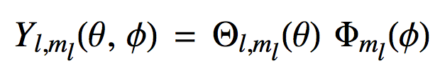
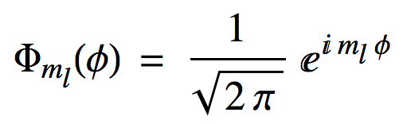
Doh!
For the angular parts of the Schrodinger equation:
We get an equation that we can’t solve with Numerov so, we will just “look-up” the solutions:
Legendre Polynomials
To visualize the orbital (density), we’ll use statistical sampling

Slide 8
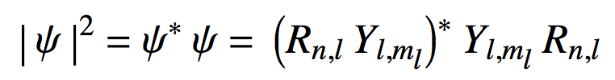
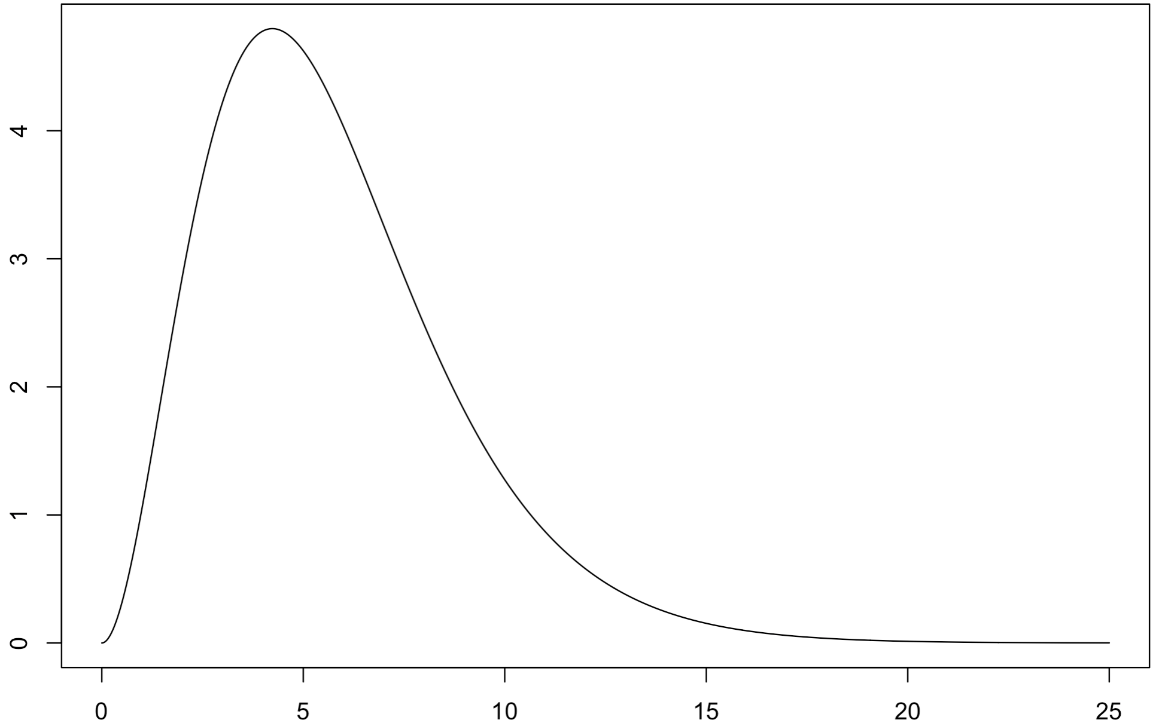
Well, … lets try something else
is a probability density.
  To “look” at a probability density, we can sample from it.
First a simple sampling example: sample from the (scaled) Planck distribution:
Scaled Planck distribution

Slide 9
Metropolis-Hastings Algorithm
The basic Metropolis(-Hastings) MCMC sampling algorithm is:^{Calderhead}
  Given current “state” x (an element of the thing you want a sample of) draw proposed “state” x* from a proposal density S(x*| x)
    Note: if PD is symmetric: S(x*| x) = S(x | x*)
  Calculate the acceptance ratio:
-or-
if PD is not symmetric this appears, and alg. called Metropolis-Hastings
  Draw U ~ Uniform(0,1)
  Let:

Slide 10

Example: (Simple, 1D) MCMC Sample from scaled Planck
target
Markov Chain Monte Carlo (MCMC) sample from the Planck distribution

Slide 11
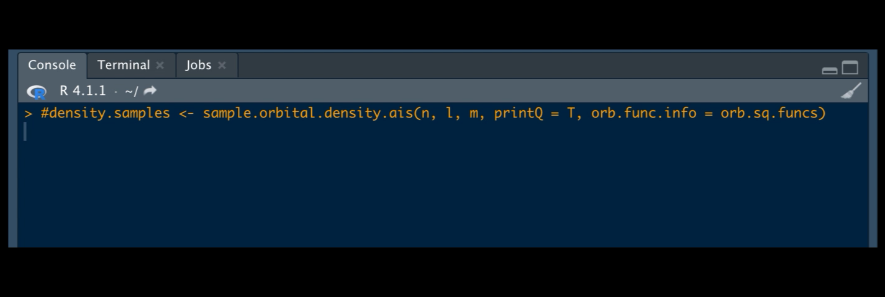
More complicated: Sampling from 3D Orbital
Lets do a 3D sample from an orbital probability density: Here the 7h₆ orbital:

Slide 12
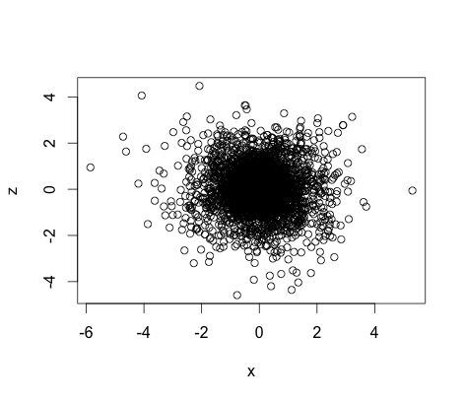
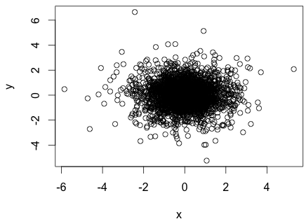
Well, … lets try something else
Lets do a 3D sample from an orbital probability density:
1s₀

Slide 13
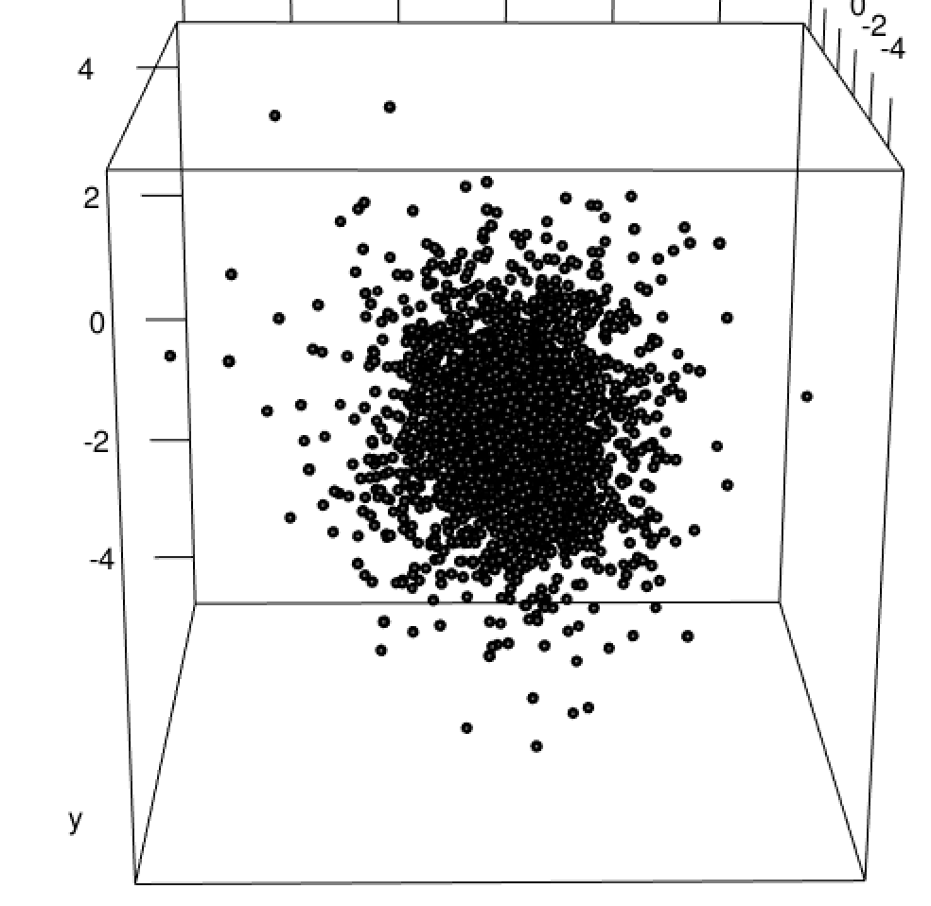
Well, … lets try something else
Lets do a 3D sample form an orbital probability density:
1s₀

Slide 14
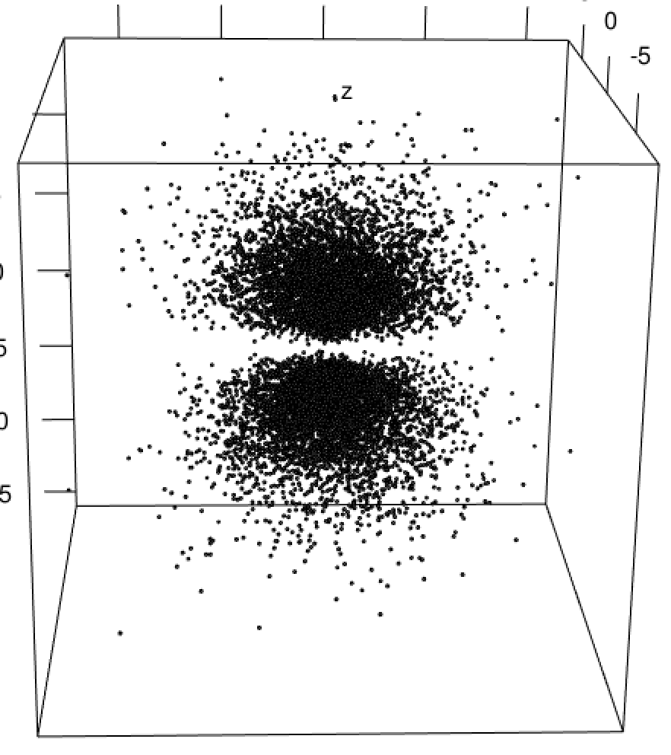
Well, … lets try something else
Lets do a 3D sample form an orbital probability density:
What orbital is this?

Slide 15
Prep for 3D Plotting in R
Macintosh people only, download and install XQuarz:
  https://github.com/XQuartz/XQuartz/releases/download/XQuartz-2.8.1/XQuartz-2.8.1.dmg
OPTIONAL for everybody: We need to install a few R packages:
# Preparation: Install these packages:
install.packages("rgl") # For 3D interactive plots
install.packages("doMC") # To do some stuff in parallel
install.packages("doSNOW") # To do some stuff in parallel

Slide 16
density.sampling.control_script.R
library(che302r)
library(parallel)
library(doSNOW)
library(rgl)
#Pick an orbital:
n <- 3
l <- (2)
m <- (-1)
# Create squared orbital functions for sampling
orb.sq.funcs <- splined.sqorb.functs(n, l, m, r.max = 50, num.knots = 1000)
rax <- orb.sq.funcs$r.axis
R.sq <- orb.sq.funcs$R.sq.func
plot(rax, rax^2 * R.sq(rax), typ="l")
plot(rax, log(rax^2 * R.sq(rax)), typ="l")
detectCores() # Number of processors available
#Sample the orbital density:
density.samples <- sample.orbital.density.ais.parallel(n, l, m, orb.func.info = orb.sq.funcs,
num.processes = 4)
x <- density.samples[,1]
y <- density.samples[,2]
z <- density.samples[,3]
#Plot the sampled orbital density:
#2D
plot(x,y)
plot(x,z)
plot(y,z)
#3D
plot3d(x,y,z,type="s",radius=0.2,xlab="x",ylab="y",zlab="z")

