Slide 1
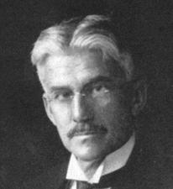
Light, Color and Imaging

Slide 2
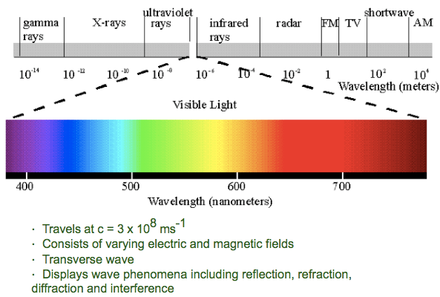
Light
The Electromagnetic Spectrum:
E = hν

Slide 3
Light ➔Color
When light impinges on a surface, lots of things can happen:
e- of the atoms absorb some of the photons
  Followed by possible vibrational relaxations in excited states
  Followed by possible intersystem crossing
  Followed by possible radiative decay (fluorescence or phosphorescence)
    This produces color if v_{emitted} = {400nm, 700nm}
  Combinations of all of the above

Slide 4
Light ➔Color
When light impinges on a surface, lots of things can happen:
e- of the atoms don’t absorb all of the photons
  There are no available states for the e- to be excited to
    These are reflected photons
    Reflected photons with v_{i} = {400nm, 700nm} produce most of the colors we see!
White light
Reflects mostly greens that our eyes are sensitive to
Absorbs reds, blues

Slide 5
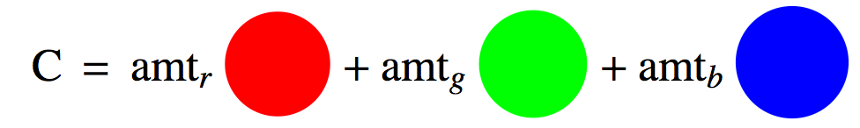
Color
So what we call color is just a bunch of hv_{i} coming from a material (reflected or emitted) which have v_{i} = {400nm, 700nm}
Grassmann’s law: the color of a test light can be matched by an additive mixture of three primary lights
  The primaries are references and can be anything.
    Common primaries:
      Red (700nm), Green (546.1nm), Blue (435.8nm)
      So a specific color, C would be:

Slide 6
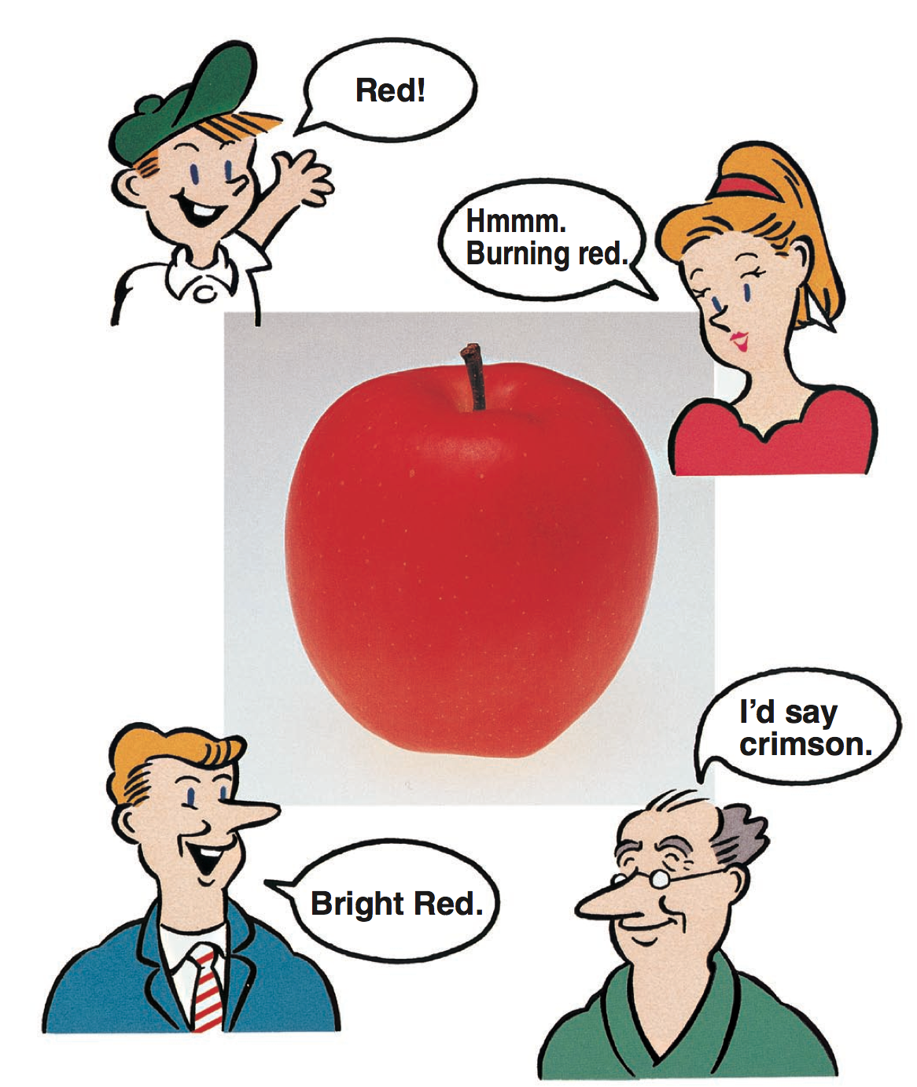
What Color Is It?
A great reference: Konica-Minolta, Precise Color Communication:
  http://www.konicaminolta.com/instruments/knowledge/color/

Slide 7
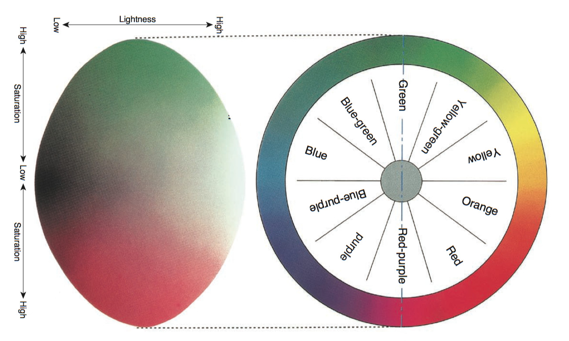
Munsell System
Hue: Basic “color” name, dominant λ
Luminosity, Lightness, Value: perceived brightness/darkness, intensity
Saturation, Chroma: vividness/dullness, purity towards dominant λ
Lightness
Hue
Saturation
Konica-Minolta

Slide 8
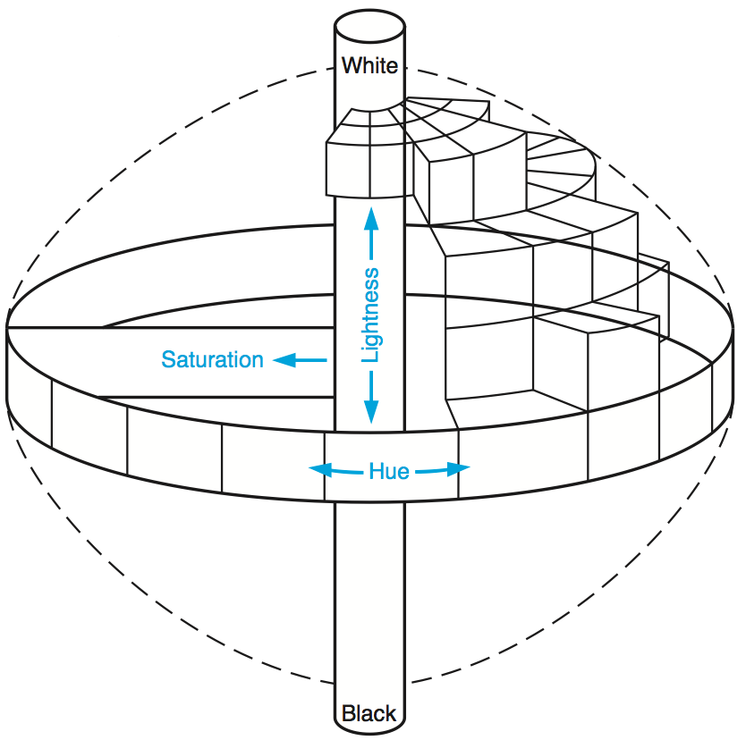
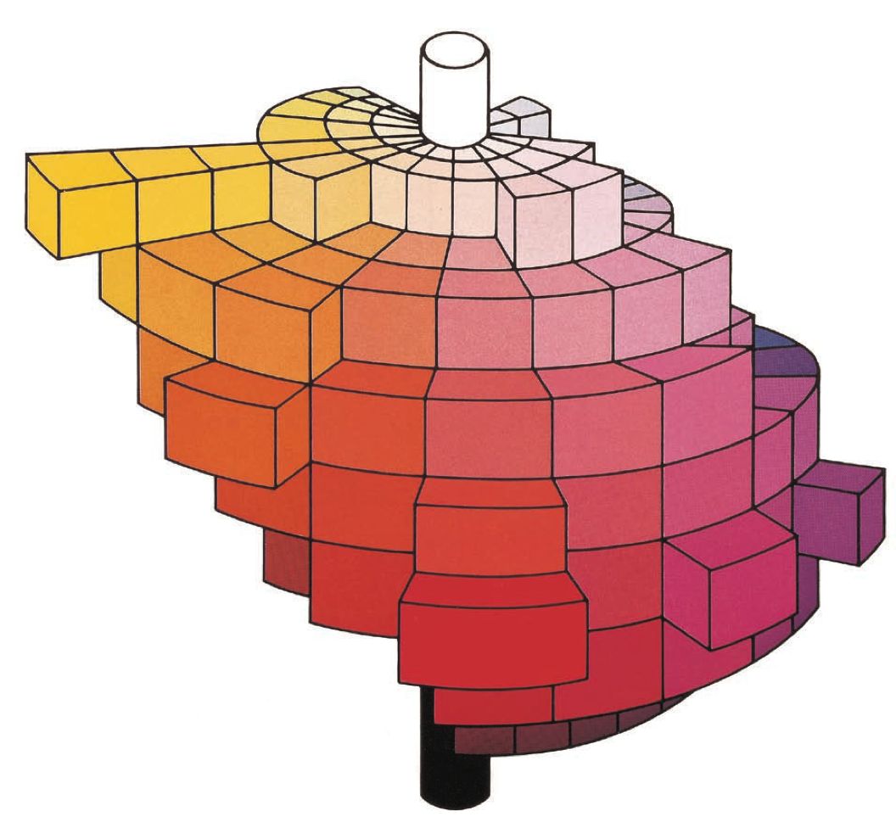
Munsell System
Konica-Minolta

Slide 9
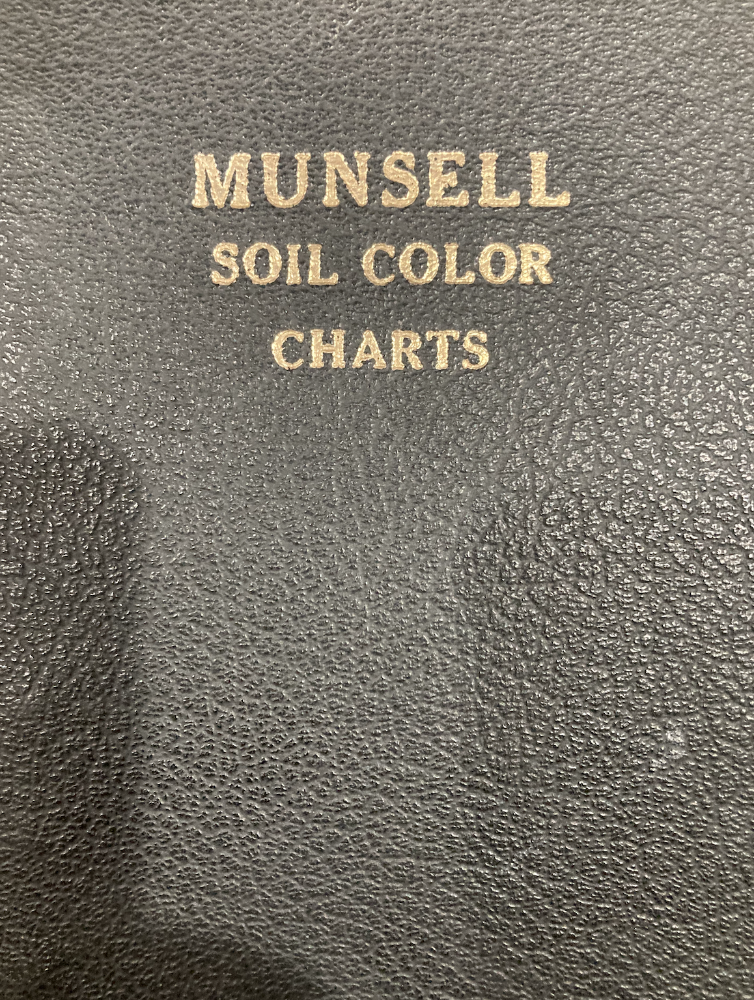
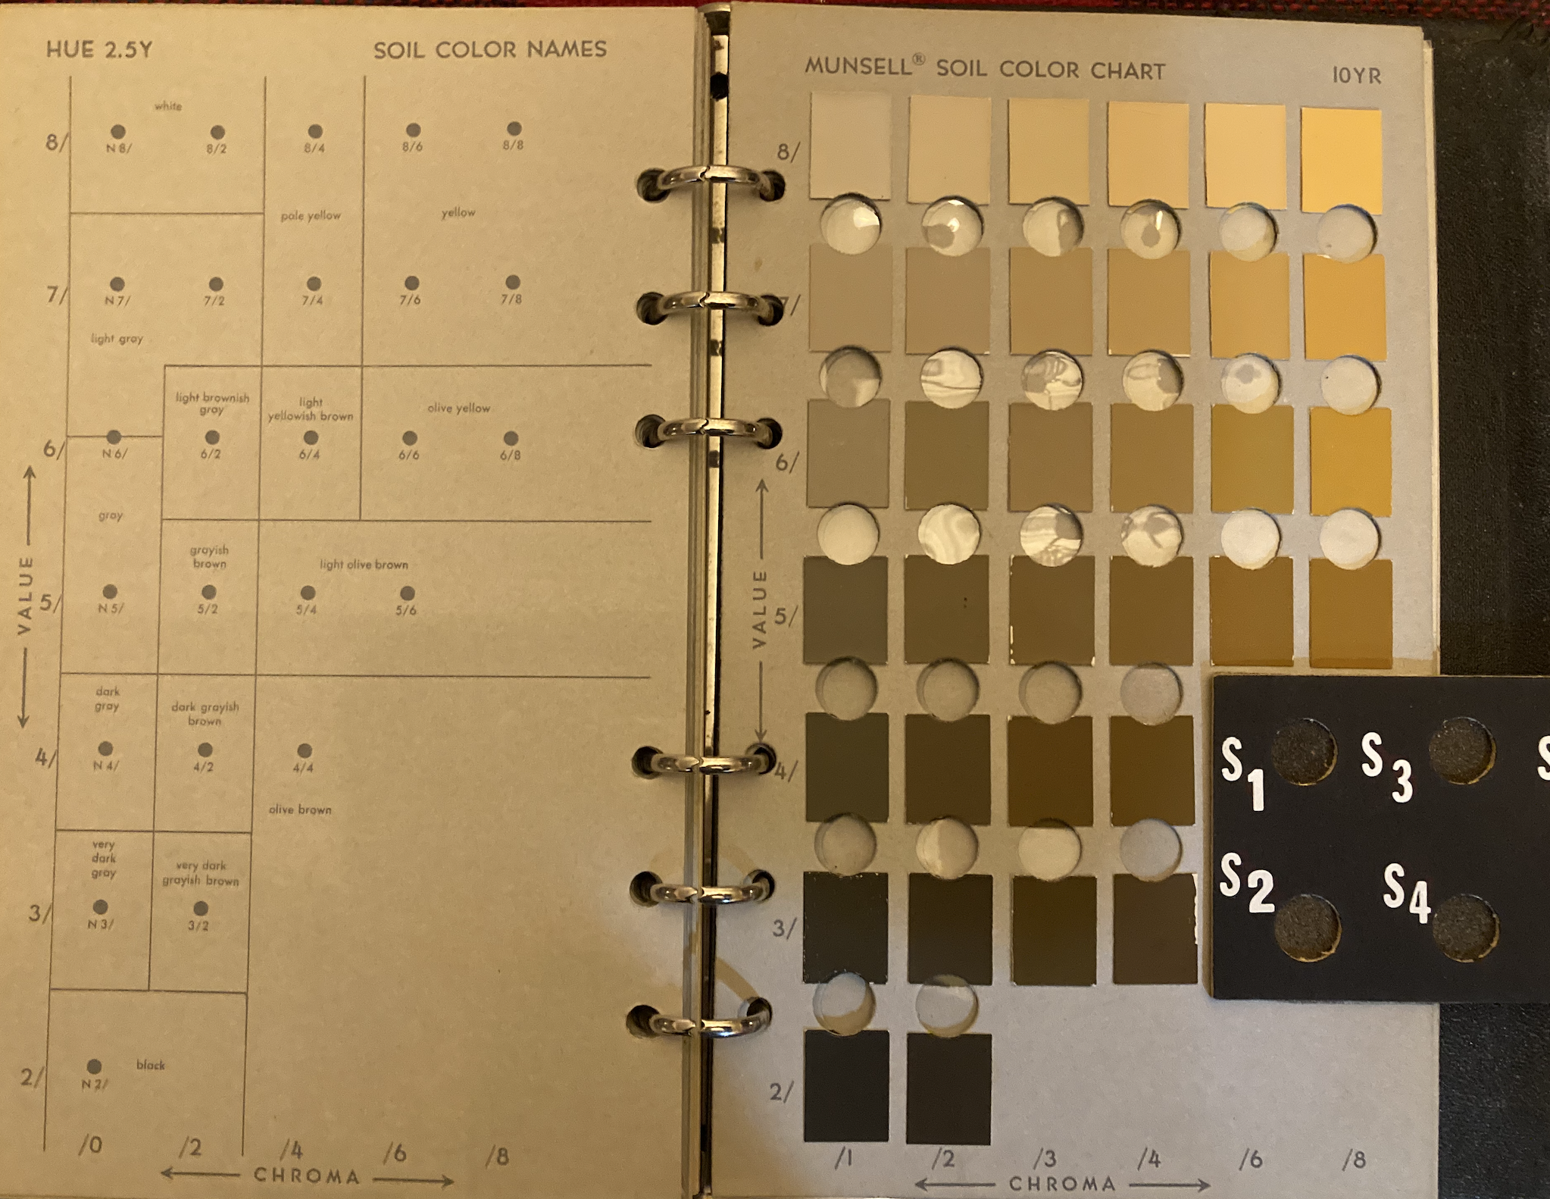
Munsell System
Hue
Chroma (Saturation)
Value

Slide 10
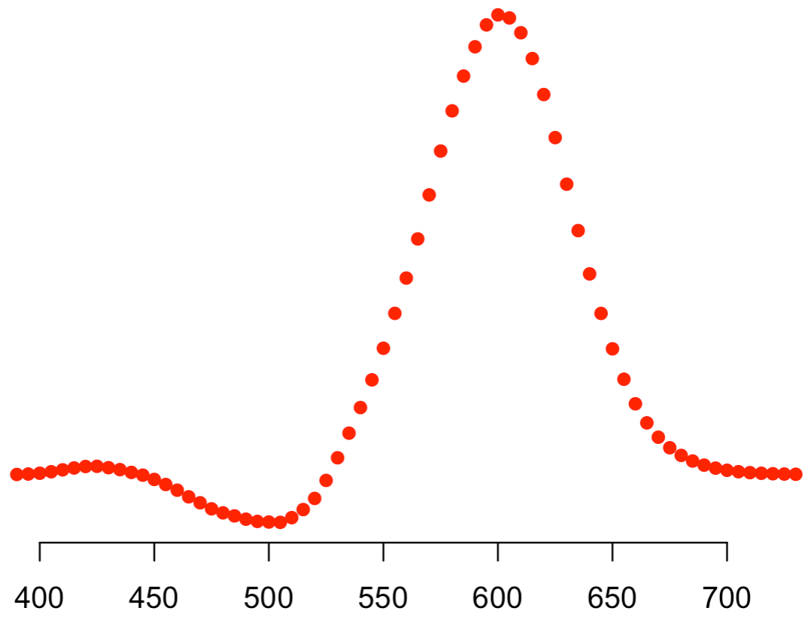
Standardization of Color
Commission Internationale de L'éclairag (CIE) 1931 color matching functions:
Test light of wavelength λ=550 nm
Ask a set of people:
How much Red (700nm) do you need?
To match a test light of this λ…
Well, I need to dial in this much Red (700nm)
λ of test light

Slide 11
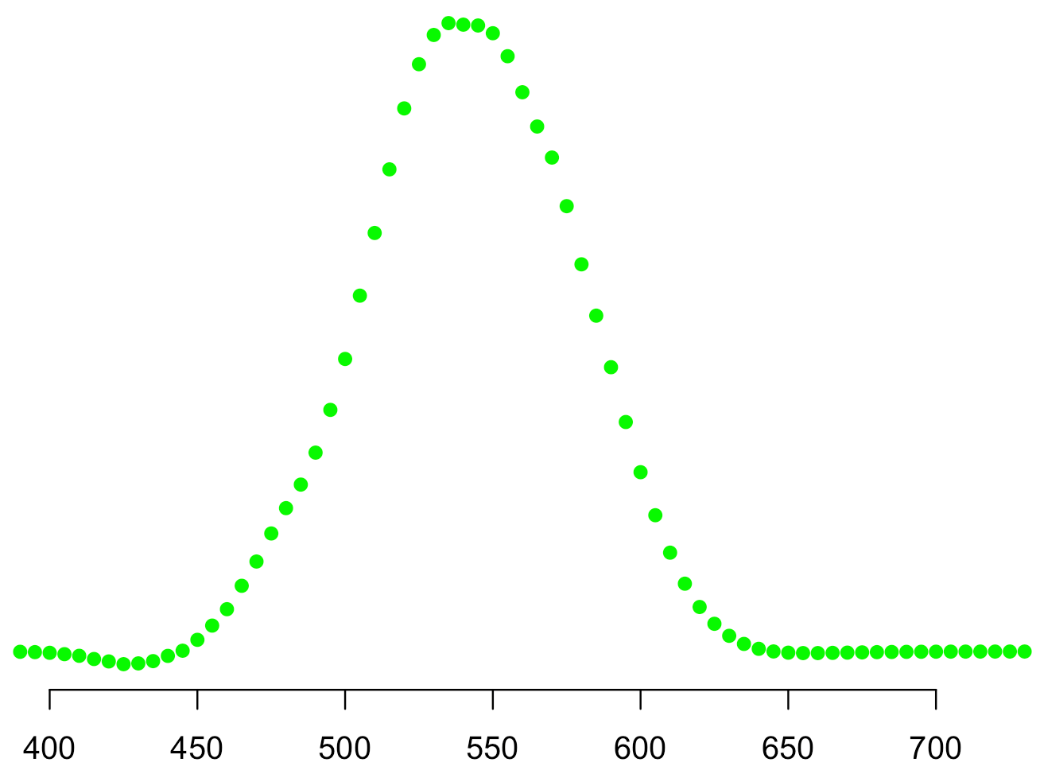
Standardization of Color
Commission Internationale de L'éclairag (CIE) 1931 color matching functions:
Test light of wavelength λ=550 nm
Ask a set of people:
How much Green (546.1nm) do you need?
Well, I need to dial in this much Green(546.1nm)
To match a test light of this λ…
λ of test light

Slide 12
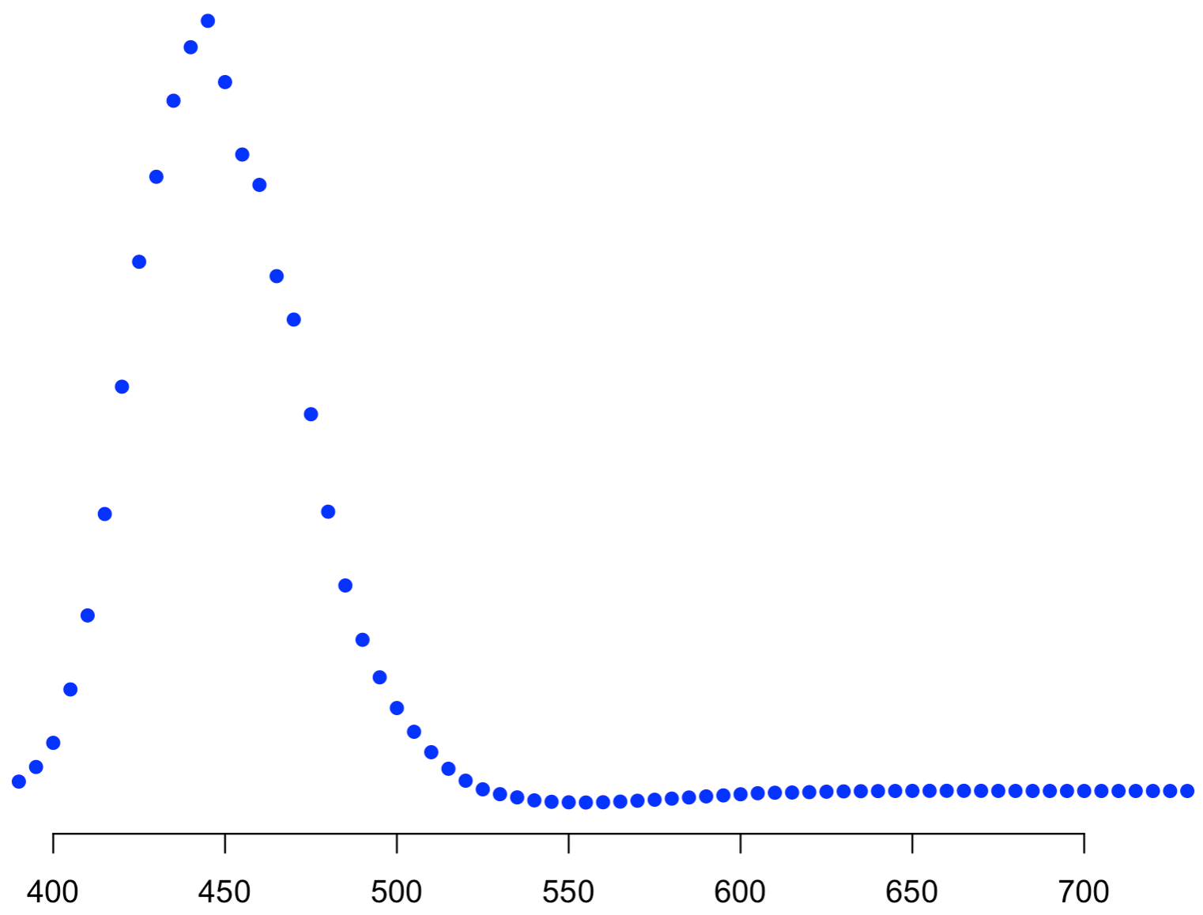
Standardization of Color
Commission Internationale de L'éclairag (CIE) 1931 color matching functions:
Test light of wavelength λ=550 nm
Ask a set of people:
How much Blue (435.8nm) do you need?
To match a test light of this λ…
Well, I need to dial in this much Blue(435.8nm)

Slide 13
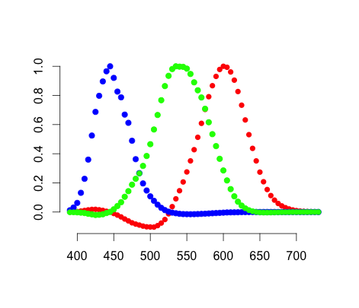
Standardization of Color
Commission Internationale de L'éclairag (CIE) 1931 color matching functions:
Ask a set of people:
How much Red, Green and Blue do you need?
Test light of wavelength λ=550 nm
To match a test light of this λ…
λ of test light

Slide 14
Standardization of Color
Commission Internationale de L'éclairag (CIE) 1931 rgb-color matching functions (rgb-cmfs):
Scaled “Amount” Units
So some of the colors are negative??
λ of test light

Slide 15
Standardization of Color
Color coordinates can be a bit difficult to visualize in a 3D volume, so well reduce the color space dimension to 2D with the trick:
rgb-chromaticity coordinates
  Normalized with respect to sum
Since r-g-b sum to 1 we can work with two out of three.
  Usually we pick (r,g)

Slide 16
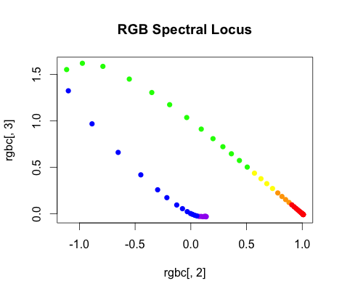
Standardization of Color
Another representation of the RGB color matching functions:
  Plot r(λ) vs. g(λ): rg-chromaticity diagram
(0,1): λ=546.1 nm
All colors within the locus are mixtures of spectral (monochromatic) colors
G
Test lights in this
quadrant required
some “negative” amount
of one of the primaries
(1,0): λ=700 nm
(0,0): λ=435.8 nm
B
R

Slide 17
Standardization of Color
All colors along a line connecting any two points can be made by mixing proportional amounts (p and 1-p) of the colors at the ends
x₁
x₃
x₂
x₁
x₁
x₃
x₃
x₂
x₂

Slide 18
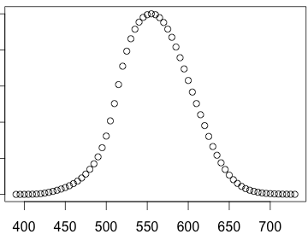
**Standardization of Color
A new set of “primaries” so all “colors” are positive quantities:
  The “luminescence” function V(λ) will be the new color matching function y(λ):
−
luminescence
λ of test light

Slide 19
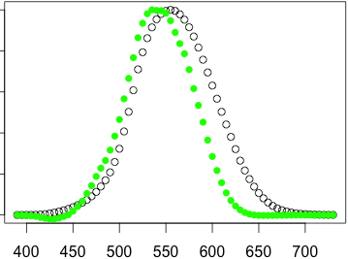
**Standardization of Color
A new set of “primaries” so all “colors” are positive quantities:
  The “luminescence” function will be the new color matching function y(λ)
−
−
g(λ)
y(λ)
λ of test light

Slide 20
**Standardization of Color
Rescaling each of the color matching functions to their relative luminescence gives the RBG tri-stimulus values

Slide 21
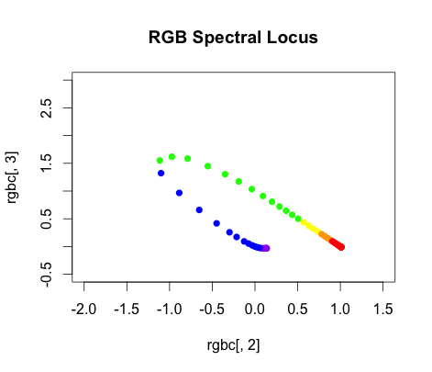
**Standardization of Color
A new set of “primaries” so all “colors” are positive quantities:
  CIE 1931 standard: Draw in a new triangle
Y
Just need to clear this point
Line just outside the spectral locus
Z
Alychne: luminescence = 0 line
X

Slide 22
Standardization of Color
Transformation to go from RGB space to XYZ space^{*Fairman}:
*Fairman et al.: How the CIE 1931 Color-Matching Functions Were Derived from Wright–Guild Data

Slide 23
Standardization of Color
To go from rgb to xyz it’s a little ugly-ier^{Fairman}:
  Most of this complication is to force y(λ) = V(λ) instead of y(λ) ≈ V(λ)

Slide 24
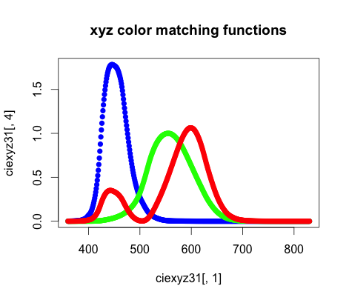
Standardization of Color
A new set of “primaries” so all “colors” are positive quantities:
  CIE 1931 standard: Make X, Y, and Z the new primaries
  Leads to the new color matching functions:
−
z(λ)
−
y(λ)
−
x(λ)
λ of test light

Slide 25
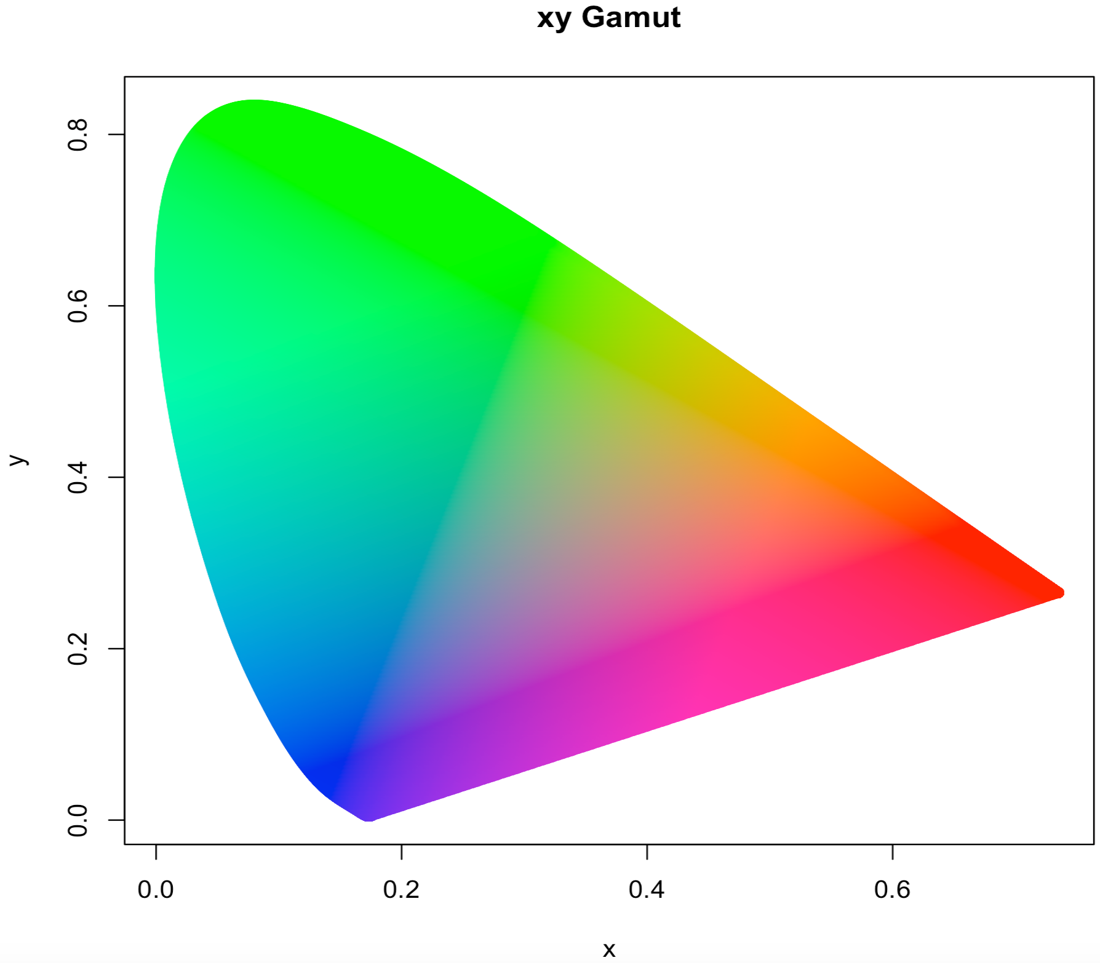
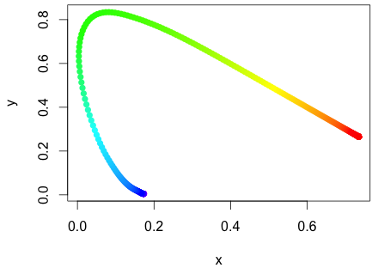
Standardization of Color
A new set of “primaries” so all “colors” are positive quantities:
  CIE 1931 standard: xy-Chromaticity coordinates (xyY system)
  Visible spectral locus

Slide 26
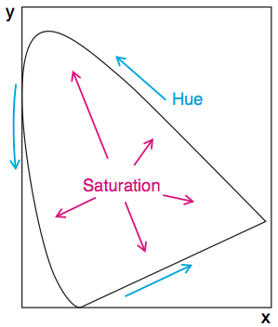
Munsell Descriptors and the Gamut
Konica-Minolta
Every x,y point in the Gamut corresponds to a set of brightness's Y

Slide 27
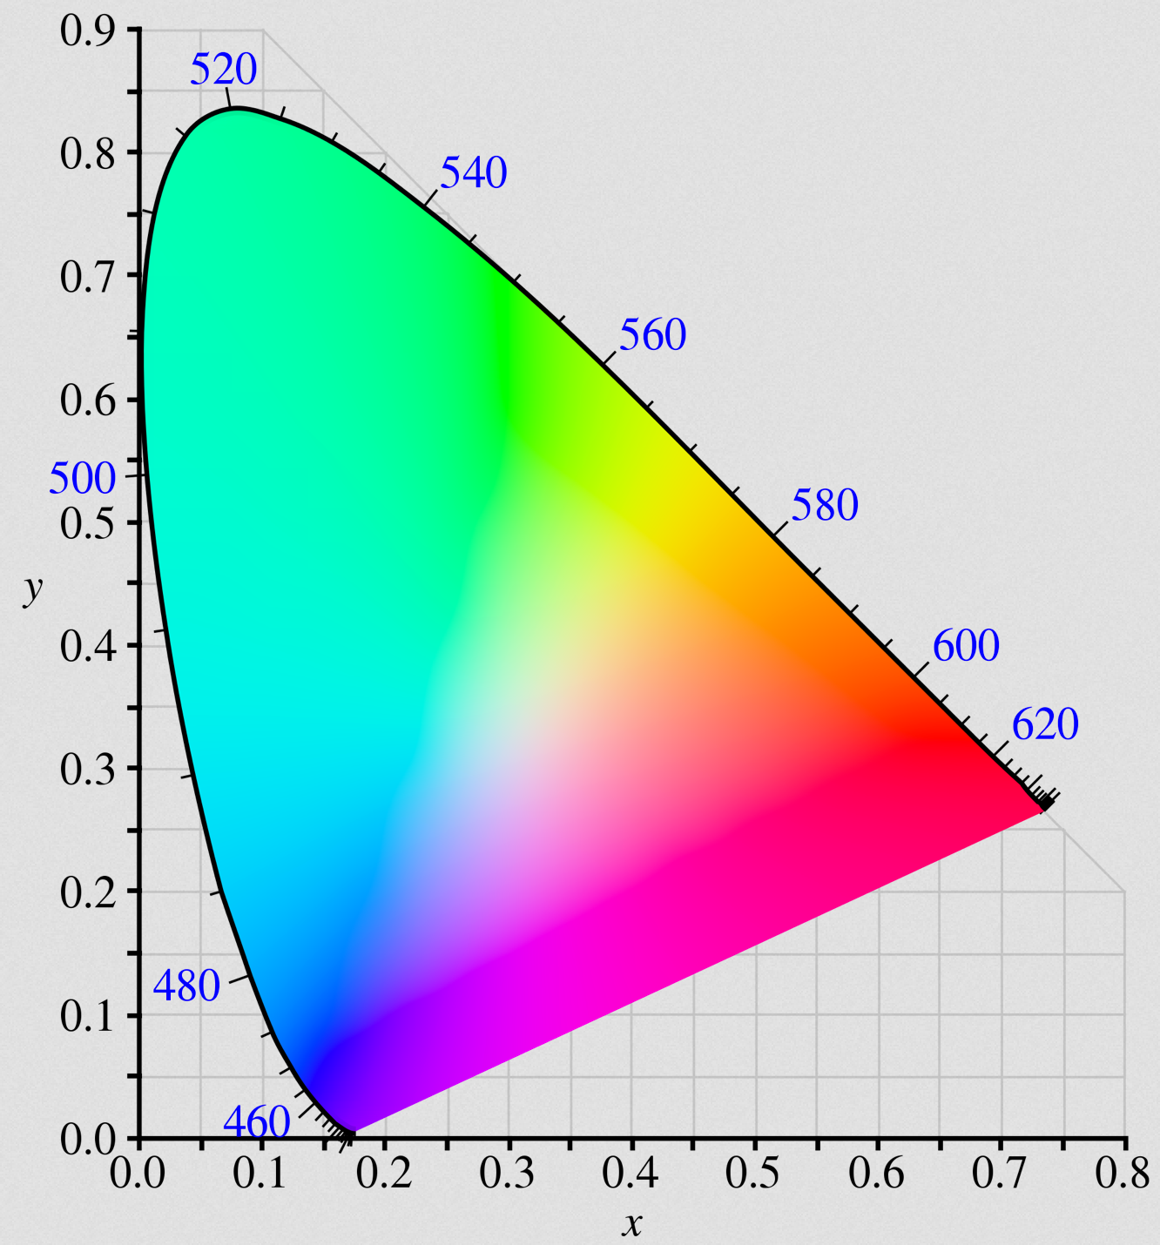
Standardization of Color
A new set of “primaries” so all “colors” are positive quantities:
  The full visible Gamut
The Gamut is a convex hull.
  Every point on the inside is a linear combination of points on the visible locus
x₁
x₂
Wikipedia

Slide 28
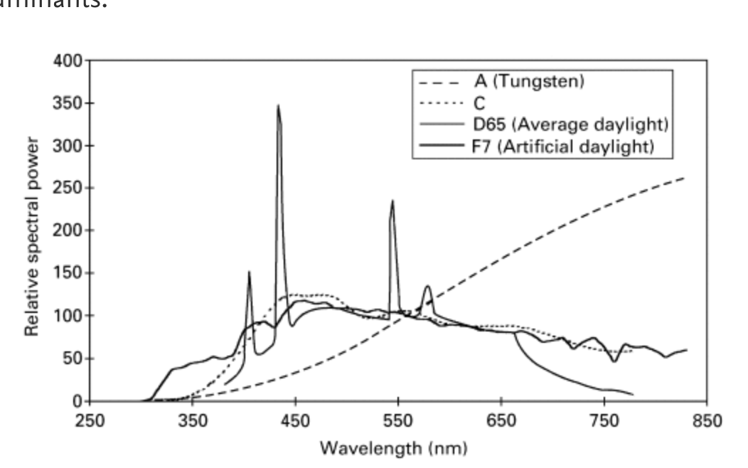
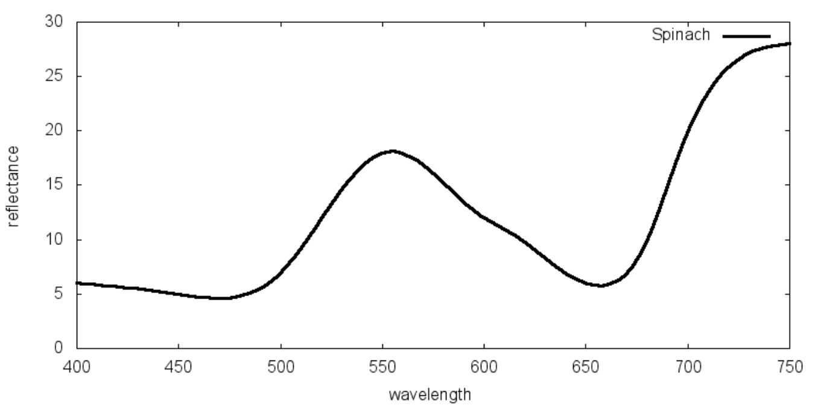
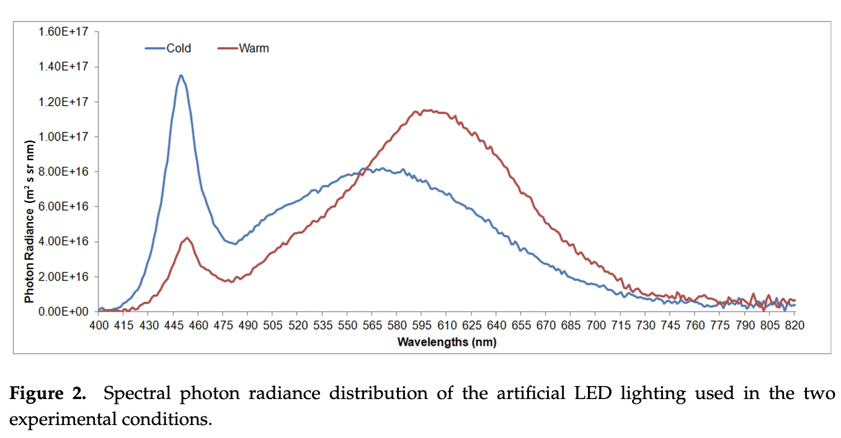
Spectral Power Distribution
Color of a complex object illuminated by some continuous wavelength source is determined by the energy intensity it “gives off” (emits or reflects) under the illuminant I(λ)
  Called the object’s spectral power distribution (SPD) (emission) or spectral reflectance distribution (SRD) (reflection): S(λ)
Gilchrist et al. 2017
I(λ)
Spinach illuminated by the sun
S(λ)
  S(λ) is a complicated function that usually has to be determined experimentally
    Dictated by illuminating source, quantum mechanics, physical structure of the material at the atomic/molecular scale, environment and viewpoint

Slide 29
Spectral Power Distribution
A complex object’s color coordinates are determined by:

Slide 30
xyY Color coordinates
Typically the color is expressed as two chromaticity coordinates and a luminosity value:
xy chromaticity
Since y(λ) is the same as the (1924) luminosity function, the (normalized) Y coordinate give a measure of color luminosity quoted as a percentage (%):
with

Slide 31

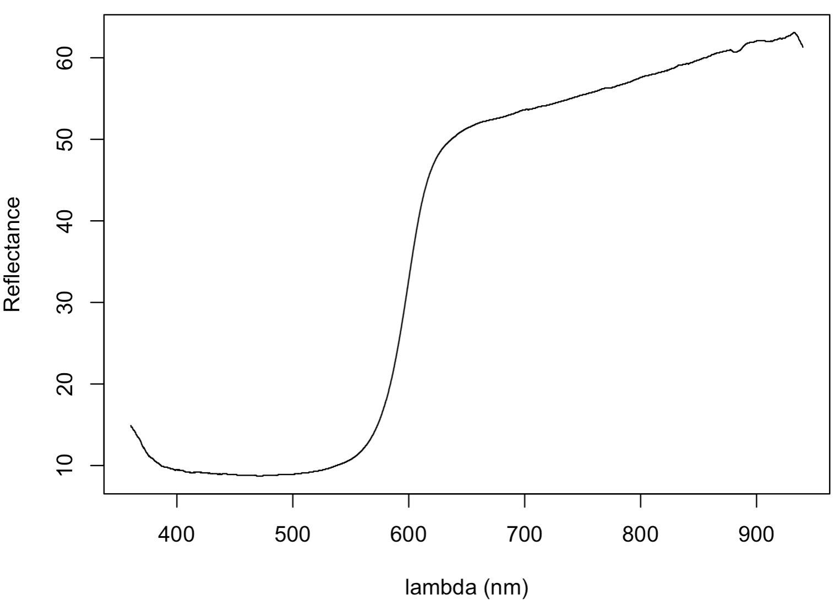
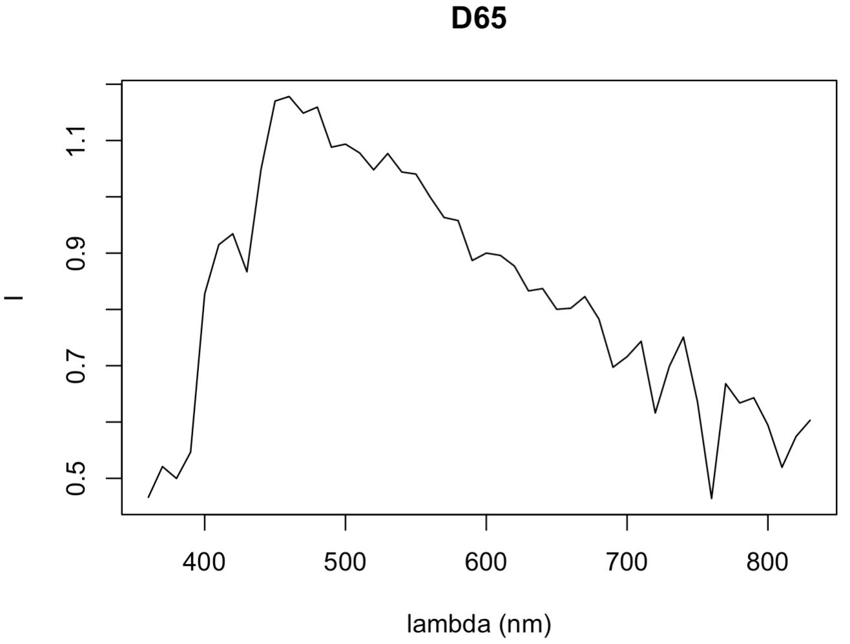
What Color Is It?
Back to the original question:
What color is it?
S(λ)
I(λ)

Slide 32
What Color Is It?
Back to the original question:
X = 0.243
Y = 0.177
Z = 0.097
What color is it?
With:
the chromaticity is (x,y)=(0.470, 0.343) with a luminosity (Y) of 17.7%

Slide 33
The Planckian Locus
Black bodies give off an energy intensity so they are SPDs.
  What color are they at a given temperature?
Project the Planck distribution at a given temperature onto the x, y and z color matching functions!

Slide 34
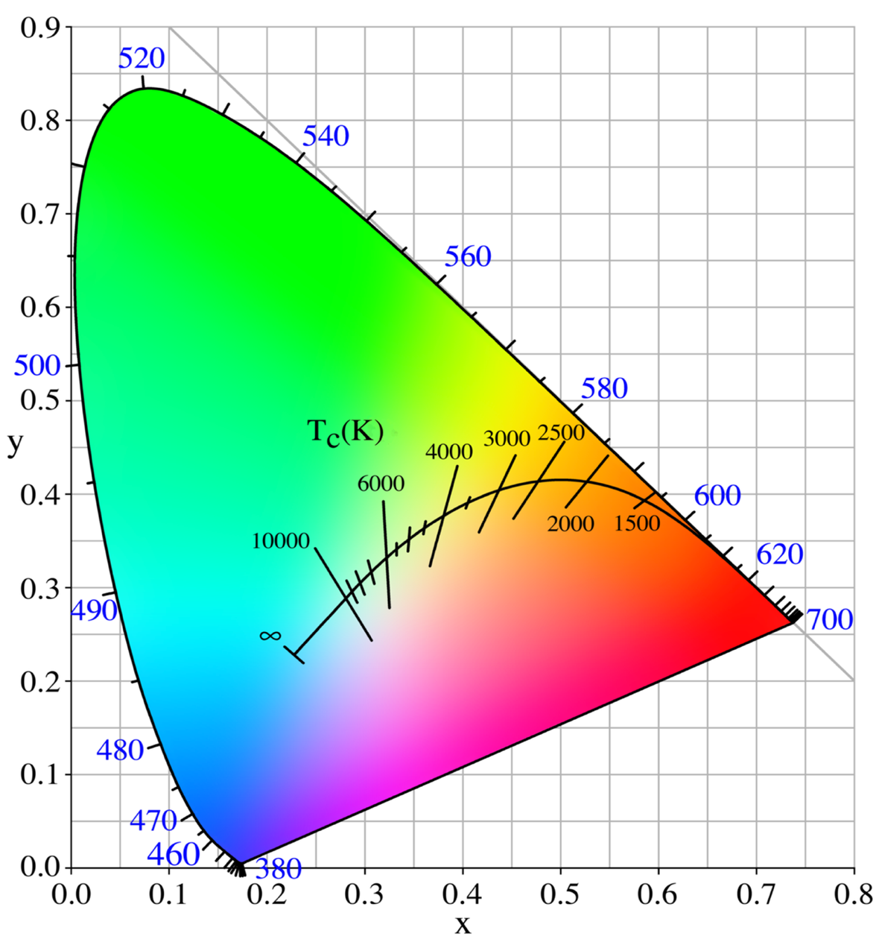
The Planckian Locus
Color Temperature
  Plot the curve of x(T), y(T) on the Gamut
White point
  Chromaticity coordinates of of a “white object” with respect to a reference illuminant.
    Reference has spectral range that simulates different kinds of light
      A: Indoor lighting
      B,C: Sim. sunlight
      D: “Natural” daylight
        D₆₅, D₅₀
G_{546.1}
R₇₀₀
B_{435.8}
Wikipedia

Slide 35
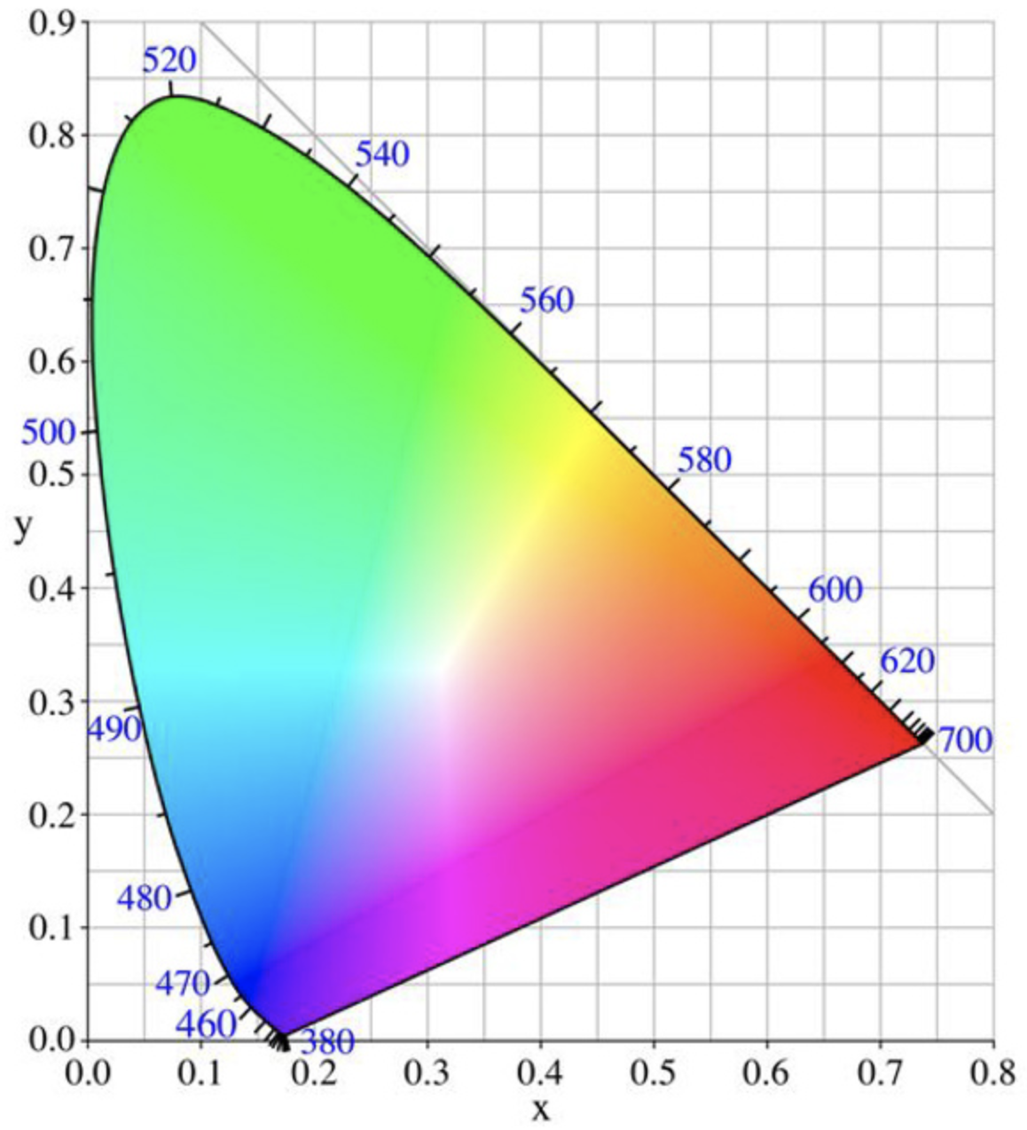
White point under reference illuminant I^{ref}(λ):
Reflectance of reference “white object”: S_{white}(λ) = 1 (usually)
Chosen white point
w = (x_{w},y_{w})
E
E equal energy white point
  S_{white}(λ) = 1, I^{ref}(λ) = 1
  x=1/3, y=1/3

Slide 36
Color purity: “closeness” of a color to it’s dominant wavelength wrt the white point:
x_{h} = (x_{h},y_{h})
x = (x,y)
Chosen white point
w = (x_{w},y_{w})
Dominant wavelength of color x is here
Purity is basically Munsell saturation on a scale of 0 to 1.

Slide 37
Example
The chromaticity coords of the white point under D65 are x_{w} = 0.31, y_{w} = 0.33. At 570nm the chromaticity coords are x_{h} = 0.44, y_{h} = 0.55.
a. Show where these chromaticities fall on the xy-Gamut:
b. Give the equation of a line for all chromaticities with a dominant wavelength at 570nm. Remember, the equation for a line given two points is:
with
c. Compute the purity of x = 0.41, y = 0.51 (it’s on the line).

Slide 38
a.
x_{h}
w^{D65}
xw <- 0.31 # D65 white point
yw <- 0.33 # D65 white point
xh <- 0.44 # 570nm
yh <- 0.55 # 570nm
m <- (yh - yw)/(xh-xw) # 570nm-D65 line Slope
b <- (yw-m*xw) # 570nm-D65 line Intercept
# b.
m <- (yh - yw)/(xh-xw) # 570nm-D65 line Slope
b <- (yw-m*xw) # 570nm-D65 line Intercept
c(m,b) # 570nm-D65 line: y = 1.69x - 0.19
# c.
xe <- 0.41
ye <- 0.51
purity <- sqrt(((xe-xw)^2 +(ye-yw)^2)/((xh-xw)^2 +(yh-yw)^2))
purity # Purity (Munsell saturation) is 81%

Slide 39
Sub Gamuts:
“green” primary
p₂
Chosen white point
w
p₁
“red” primary
p₃
“blue” primary

Slide 40
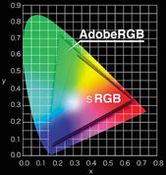
Digital Imaging: Standard Gamuts for RGB
Olympus

Slide 41
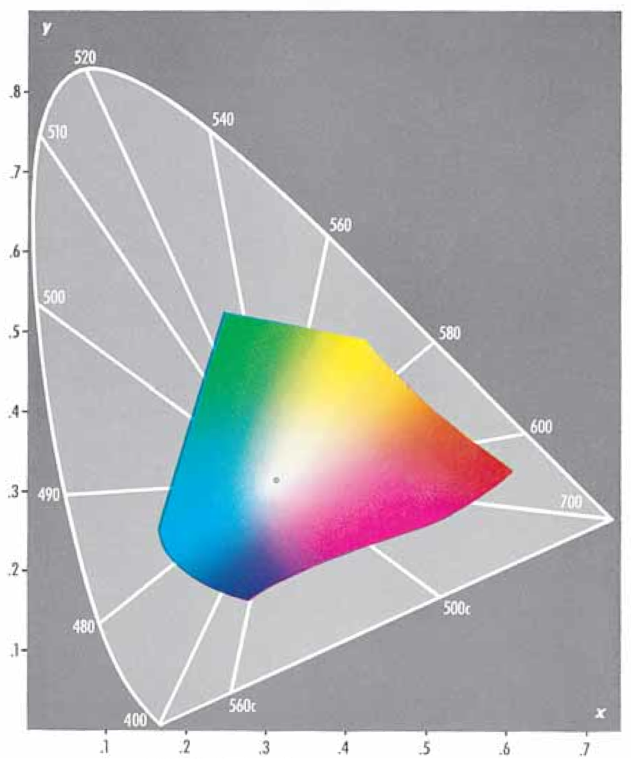
Gamut of Printed Inks
Kodak 1996

Slide 42

Peter V Tytell
Peter contributed endlessly to Forensic Science, and inspired these lectures

