Slide 1
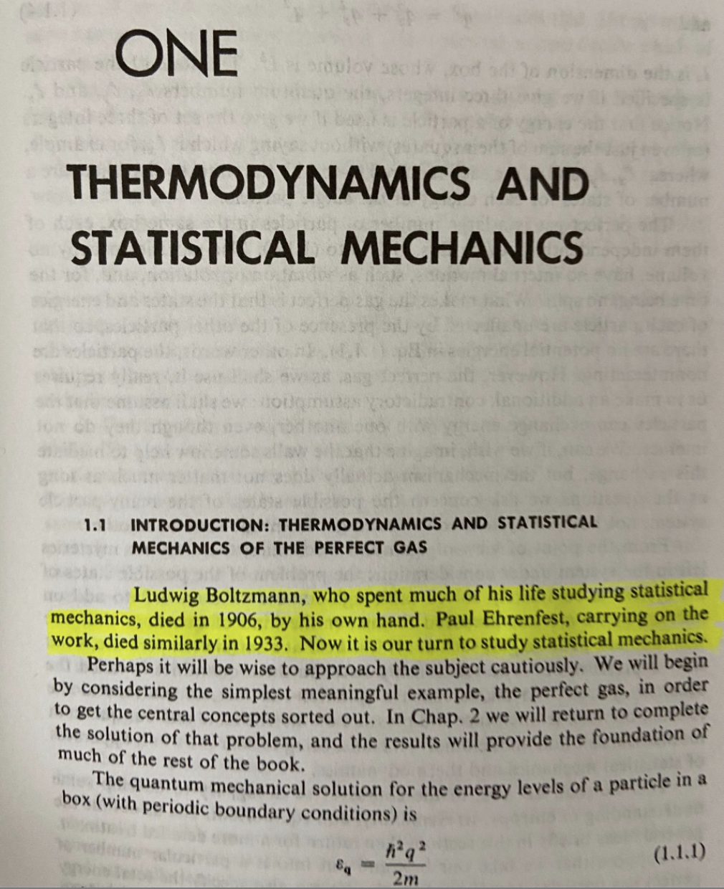
Fun with PIAB Partition Function
-DL Goodstein, States of Matter, ISBN-10: 048664927X 🤔
Problem Set: the Maxwell-Boltzmann gas

Slide 2
Boltzmann distribution
A form of the Boltzmann distribution that we can work a little more easily with is:
Probability density for energies of the system
density of states: number of states with energy E_{j}
Partition function

Slide 3
Density of States
Depending on the system, the number of states in the sum is usually enormous!
If we can get a formula for the density of states however, we can do the sum approximately as:

Slide 4
Density of States
For particles in a 3D box, with some care we can get a formula for the density of states
Remember: any particle in the box has energy:
A state can be represented as a vector
k_{x}
k_{y}
k_{z}
  Every n_{x}, n_{y} and n_{z} that gives the same |k| (or k²) has the same E.
    So, every state on the surface of a sphere of radius |k| (in “k-space”) has the same energy.

Slide 5
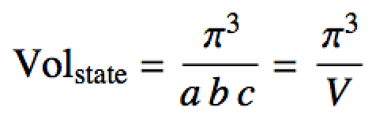
k-space
We can determine by using the “volume” (the number of states) of a shell in k-space.
dk
The surface area of the top eighth of a sphere is:
One box contains
one state in k-space
k_{y}
So, the number of states covering this chunk is:
k
(0,0,0)
k_{x}
k_{z}
The number of states in a volume between k and dk is then:

Slide 6
k-space
We can determine by using the “volume” (the number of states) of a shell in k-space.
dk
So, the number of states in a volume between k and dk is:
A state in k-space
k_{y}
With:
k_{x}
we can change variables from k to E with a u-substitution:
k_{z}
Energy degeneracy in a box of particles

Slide 7
In case you’re interested about how the u-substation works:
With:
Implies (remember these?? 😃)
Abbreviated notation of above, but sloppy
Jacobian
Can now see purpose of Jacobian is to preserve “volume” under change of variables

Slide 8
In case you’re interested about how the u-substation works:
With:
and
then:
and
so:
Energy degeneracy of many independent particles in a box of particles (Maxwell-Boltzmann gas degeneracy)

Slide 9
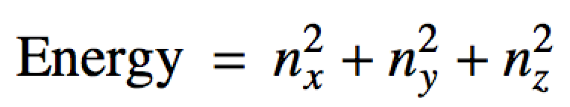
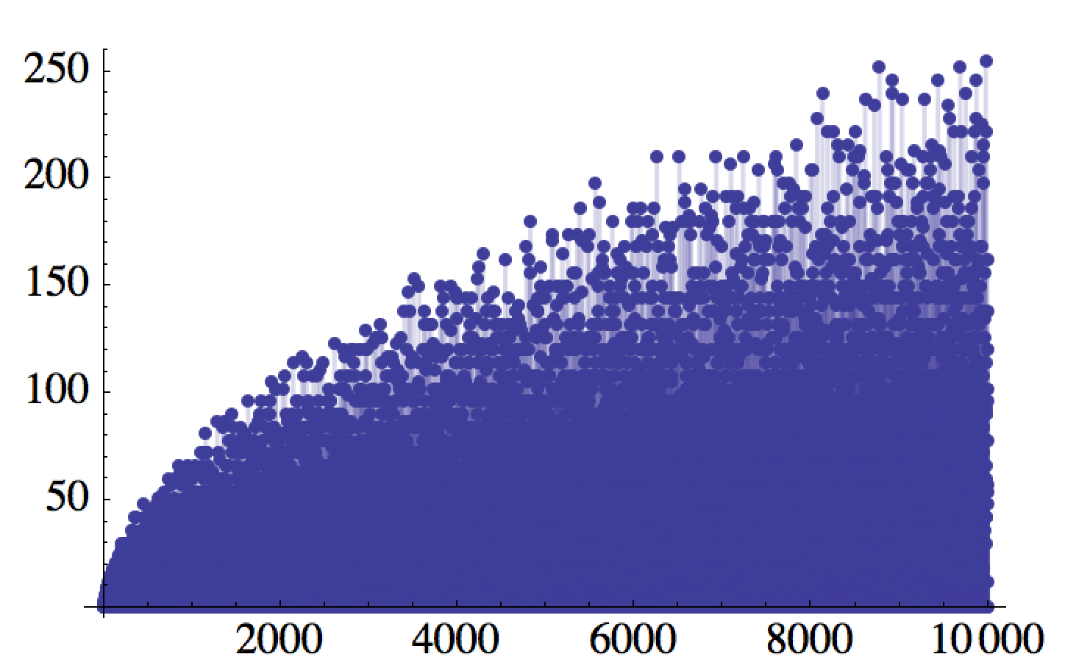
Another Look at Energy Degeneracy in the Box
From the PIAB unit, solving a Diophantine equation:
# of states
Energy

Slide 10
Maxwell-Boltzmann distribution
a. Use to get Z with:
g[e_] := (m^(3/2) V)/(Sqrt[2] Pi^2 hb^3) Sqrt[e];
Integrate[g[e] Exp[-e/(kB*T)], {e, 0, Infinity}]
b. Substitute result Z in the Boltzmann distribution to obtain p(E).

Slide 11
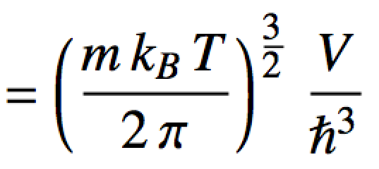
Maxwell-Boltzmann distribution
a. Use to get Z:
Substitute result Z in p(E) to obtain the pdf:
Maxwell-Boltzmann “Distribution” for distinguishable, independent particles in a box (i.e. a Maxwell-Boltzmann gas)

Slide 12
Maxwell-Boltzmann distribution
What does this probability density like like? Plot p(x) with x = E/(k_{B}T).

Slide 13
Maxwell-Boltzmann distribution
x <- seq(from=0, to=7, length.out=100)
p <- (2/sqrt(pi)) * sqrt(x) * exp(-x)
plot(x,p, typ="l", xlab="x=E/(kBT)", ylab="(kBT)^3 p(E)", main="Maxwell-Boltzmann")

Slide 14
Maxwell-Boltzmann distribution
What does this probability density like like?
Draw a particle from the box. What energy is it most likely to have?
(k_{B}T)³ p(E) (scaled density)
Past how much energy do you not expect to find too many particles?
x = E/(k_{B}T) (scaled energy)

Slide 15
3D Box/Degeneracy problem
  Consider a 3D box (side length 1 dm) filled with 1 mol of HCl gas (36.46 g/mol) at 273 K.
    Compute the log of the partition function.
    Assuming the HCl molecules occupy P.I.A.B. states, approximately how many states are available up to an energy of 1k_{B}T at 273K. Hint: Compute
    Do it symbolically first. Log the result, plug in and then “e” back. That is better form.
    Compute the probability of reaching into the box and pulling out an HCl molecule of energy between 0 J and 1k_{B}T at 273K. Hint: Compute

Slide 16
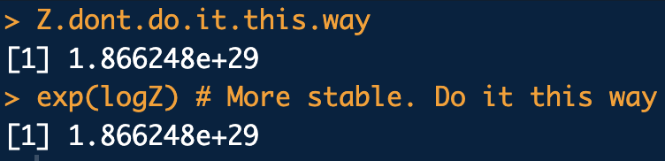
3D Box/Degeneracy problem
a.
library(che302r)
m <- 36.46 * 1/N.A * 1/1000 # convert g/mol -> kg/molec
Temp <- 273
Vol <- 1 * (1/10)^3 # convert dm^3 -> m^3
# Z just by plugging in to the formula:
Z.dont.do.it.this.way <- (m*kB*Temp/(2*pi))^(3/2) * Vol/hb^3
Z.dont.do.it.this.way
# Z by computing with logs. Usually do it this way:
logZ <- (3/2) * (log(m) + log(kB) + log(Temp) - log(2*pi)) + log(Vol) - 3* log(hb)
exp(logZ) # More stable. Do it this way
Z ~ 10²⁹

Slide 17
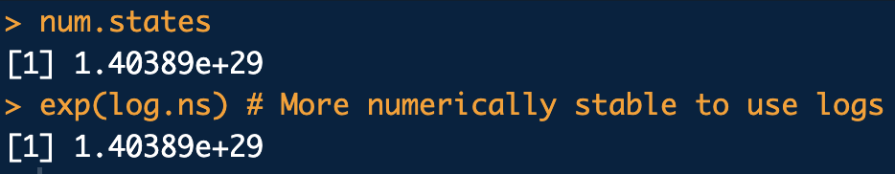
3D Box/Degeneracy problem
b.
g[e_] := (m^(3/2) V)/(Sqrt[2] Pi^2 hb^3) Sqrt[e];
Integrate[g[e], {e, 0, kB T}]
library(che302r)
m <- 36.46 * 1/N.A * 1/1000 # convert g/mol -> kg/molec
Temp <- 273
Vol <- 1 * (1/10)^3 # convert dm^3 -> m^3
# int g(e) just by plugging in to the formula:
num.states <- sqrt(2) * m^(3/2) * Vol * (Temp * kB)^(3/2) / (3*pi^2*hb^3)
num.states
# g(e) by computing with logs. Usually do it this way:
log.ns <- (1/2)*log(2) + (3/2)*log(m) + log(Vol) + (3/2)*(log(Temp) + log(kB)) - log(3*pi^2) - 3*log(hb)
exp(log.ns) # More numerically stable to use logs.
~ 10²⁹ states are available between 0J and 1k_{B}T ≈ 3.8×10⁻²¹J
…just a coincidence the magnitude is the same as Z

Slide 18
3D Box/Degeneracy problem
c.
def.:

Slide 19
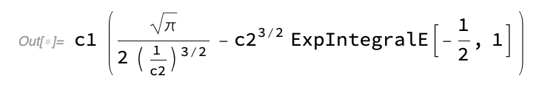

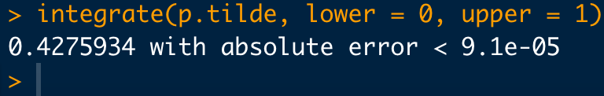
3D Box/Degeneracy problem
c.
X
(*Definite integral: c_1\int_0^{c_2}\sqrt{x}\ e^{-\frac{x}{c_2}}\ dx *)
intval = c1*Integrate[Sqrt[x] Exp[-x/c2], {x, 0, c2}];
intval//Print;
kB = 1.380649*10^(-23);
T = 273;
c2 = kB*T;
c1 = 2/((c2)^(3/2)*Sqrt[Pi]);
intval
# Do the integral numerically (with a u-substition first) in R instead:
# Substitute x = e/(kB T), dx=1/(kB T) de:
p.tilde <- function(x){
val <- 2/sqrt(pi) * sqrt(x) * exp(-x)
return(val)
}
xx <- seq(0, 6, length.out=1000)
plot(xx,p.tilde(xx), typ="l")
integrate(p.tilde, lower = 0, upper = 1)

